Slide 1

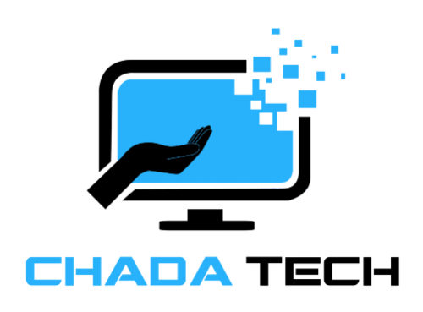
AGILE DEVELOPMENT

Slide 2

Explaining agile Roles
Product Owner
Optimizing the product's value and enhancing the efficiency of the Development Team's efforts.
Scrum Master
Offers direction in agile principles
Acts as a servant-leader to the product owner.
Supports Scrum ceremonies.
Development Team
Comprising of Developers and Testers
Autonomously organized
Multi-disciplinary

Slide 3
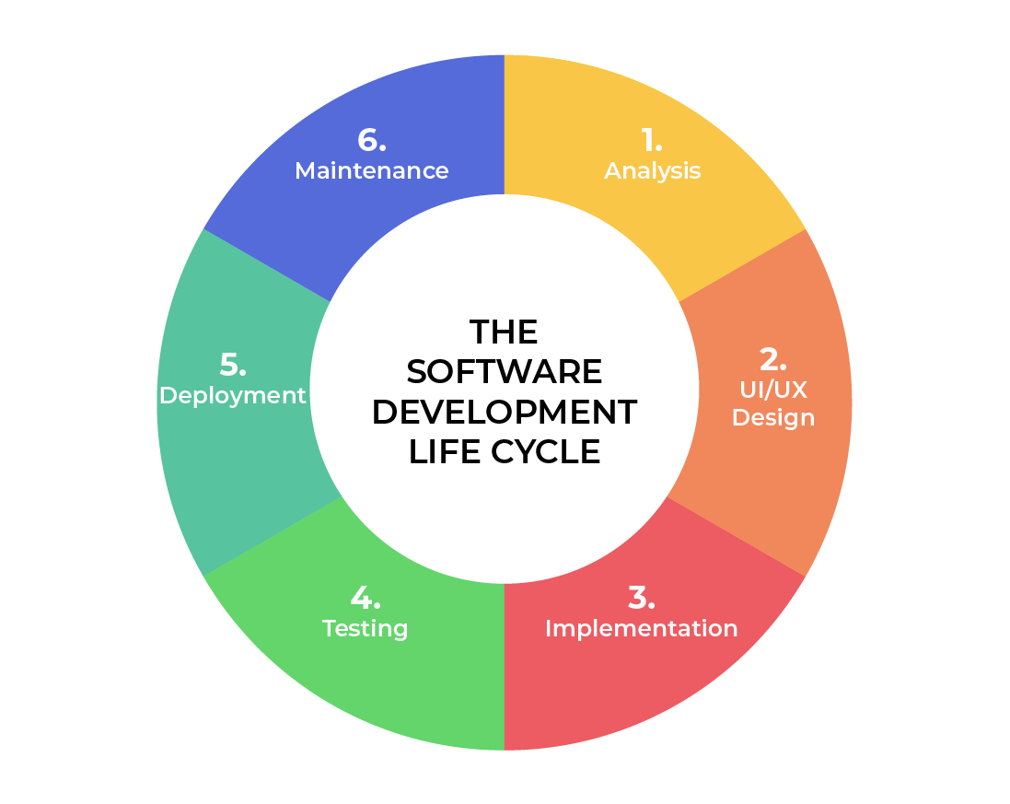
SOFTWARE DEVELOPMENT LIFECYCLE
Analysis
Work closely with stakeholders.
Collect requirements.
Design
Specify a detailed process for functionality.
Specify technologies, constraints, timelines, and budget.
Implementation
The development process commences.
Functionality is divided into smaller increments.
Testing
Occurs concurrently with development.
Procedure for identifying and mitigating reported defects and tracking issues.
Deployment
Testing is finished and the product is released to the market.
Maintenance
Product deployed in the production environment.
Developers need to be prepared to implement new features and address bug fixes promptly..
Notes:
Analysis –This stage forms the foundation of the software development lifecycle, where leadership works with diverse stakeholders to gather project requirements.
Design – During this phase, the functionality is detailed. Discussions include technologies, project resources, constraints, timelines, and budgets.
Development – During this phase, development commences. The choice of programming language depends on the project. This phase is the longest in the SDLC, as each functionality is divided into smaller increments to facilitate value-driven code development.
Testing – Testing is conducted concurrently with development, a routine activity throughout all phases but particularly focused on identifying and tracking defects within the existing code base.
Deployment – At this stage, testing concludes, and the product is prepared for market deployment. UAT (User Acceptance Testing) might occur in a controlled environment prior to release.
Maintenance – At this stage, the product has been launched into the market. Developers need to be prepared to handle new feature requests and bug fixes reported by users in the production environment.

Slide 4
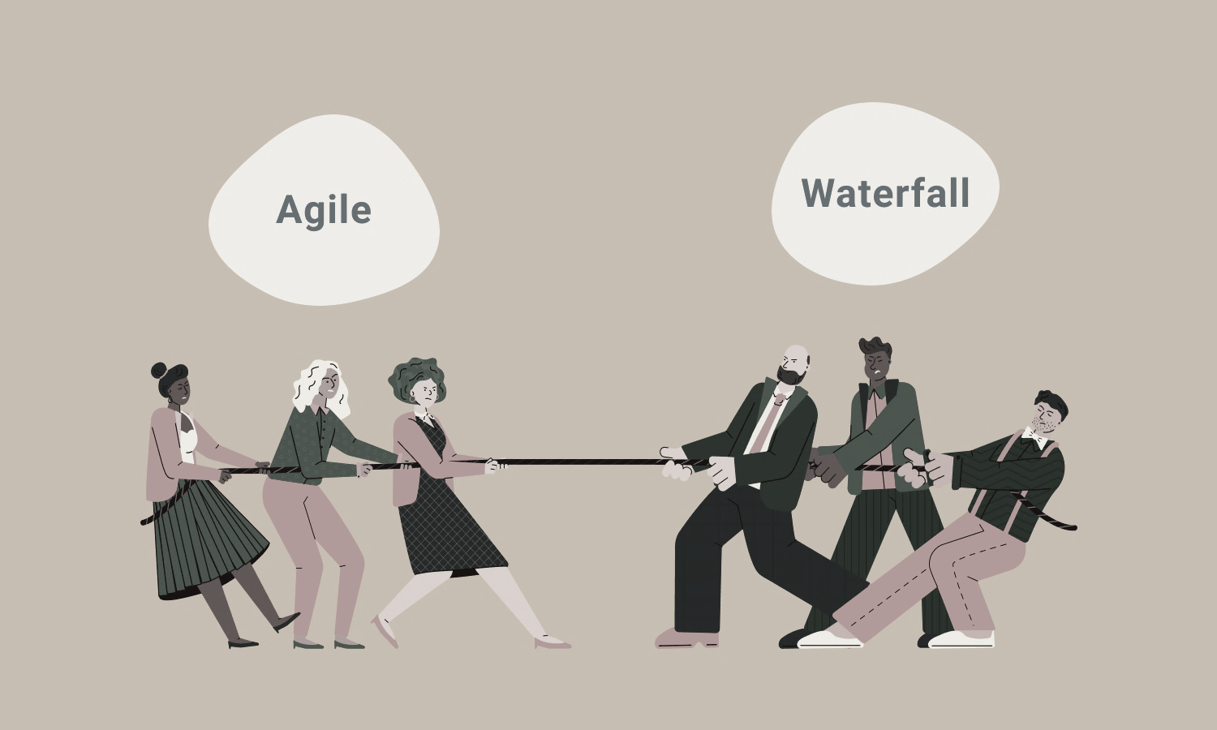
vs
Not necessary to define all requirements.
Primary requirements can be defined, but functionality may evolve over time.
No constraint on time to market
Complete definition of all requirements is necessary.
Negotiating the contract
Sequential or linear stages
Ideal for straightforward, stable projects
Notes:
Completing the SNHU Travel project under a waterfall approach would have been challenging. Uncertainty and changes could have significantly impacted the project negatively. While Agile accommodates uncertainty better, any issues found still necessitate change orders to the agreement, which can incur costs.

Slide 5
References
Charles G. Cobb. (2015). The Project Manager’s Guide
to Mastering Agile : Principles and Practices for an Adaptive Approach. Wiley. Software Development Life Cycle (SDLC). (2021, May 19). Retrieved June 2024, from
linkedin.com: https://www.linkedin.com/pulse/software-development-life-
cycle-sdlc-tutorial-richard-harris/

